Slide 1

Detecting Deep Fake Faces
By: Rahul torlapati
Data 606
https://github.com/rahultorlapati/DATA606

Slide 2
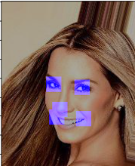
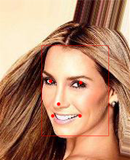
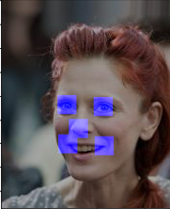
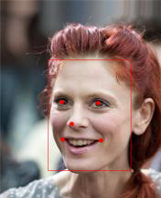
Preprocessing
The images from CelebA dataset are in the dimension of 178*218
The images from Fake Faces dataset are in the dimension of 1024*1024
These images are resized into 224*224

Slide 3
Preprocessing
There are 202,599 images in the CelebA dataset and 160,000 images in the Fake Faces dataset.
These datasets are divided into real_train and real_test and fake_train and fake_test datasets.
A random sample of 5000 images from each dataset are used as dataset for model building.

Slide 4
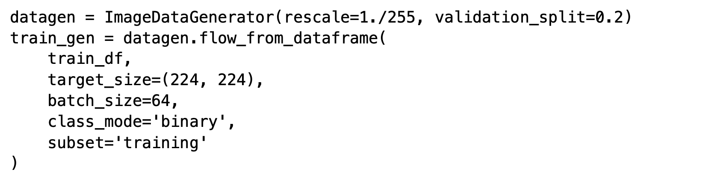
Image Preprocessing
This class generates batches of tensor image data with real-time data augmentation. The data will be looped over in batches.

Slide 5
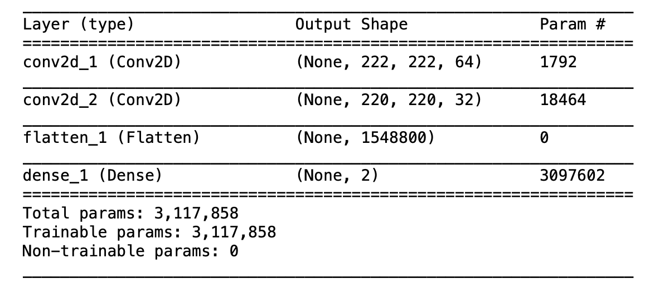
Model Building
The model type that we will be using is Sequential. Sequential is the easiest way to build a model in Keras. It allows you to build a model layer by layer. We use the add() function to add layers to our model.

Slide 6
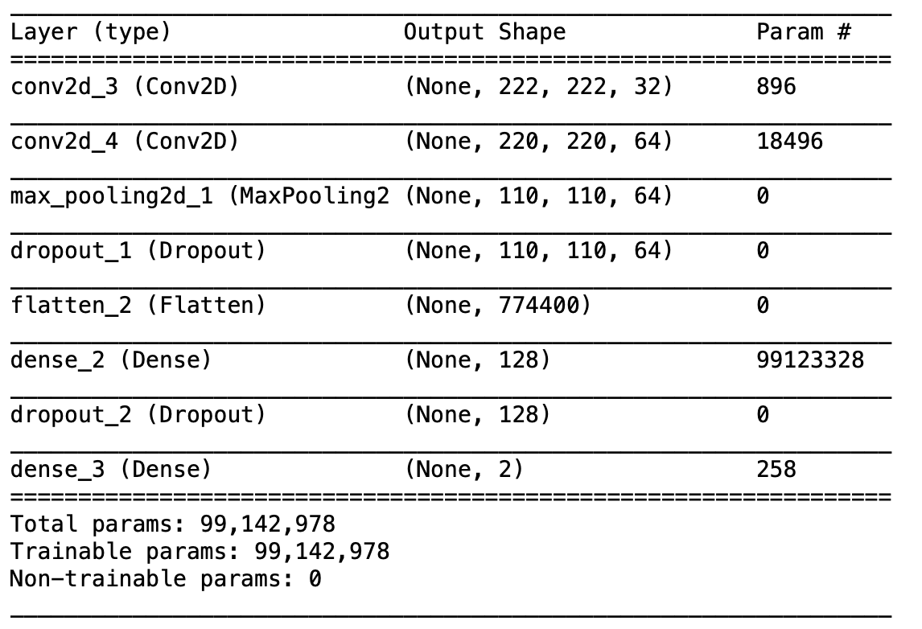
Model Building

Slide 7
Output
Each model is run for 7 epochs
The simple Convolution network took 127 sec for each epoch to run
The Complex Network took about 126 sec for each epoch
These models are currently overfitting

Slide 8
Next Deliverable
Build a complex neural network using multiple convolution layers and employ recursive neural networks and LSTMs
Use pretrained DenseNets and InceptionNets

